Slide 1
Rockbuster Stealth LLC
2020 Company Strategy Presentation

Slide 2
About us
Rockbuster Stealth LLC is a movie rental company that formally had stores around the world. Because of the stiff competition from streaming services such as Netflix and Amazon Prime, the management team is planning to use our existing movie licenses to launch an online video rental service to stay competitive. In order to come up with a plan, we need to answer key business strategy questions using insights from the current data we have.

Slide 3
Business strategy questions
Revenue
Rental Duration
Which movies contributed the most/least to revenue gain?
What was the average rental duration for all videos?
Footprint
Sales
Which countries are Rockbuster customers based in?
Do sales figures vary between geographic regions?
Customers
Where are customers with a high lifetime value based?

Slide 4
COMPANY OVERVIEW

Slide 5








current statistics
Movie Count: 1000
Release Year: 2006
Rental Rates: $0.99, 2.99, 4.99
Language of films: English
109 Countries
599 Customers
2
Stores
2
Employees

Slide 6
Rental OVERVIEW
 | Minimum | Maximum | Average | Mode
Rental Duration | 3 Days | 7 Days | 5 Days
Rental Rate | $0.99 | $4.99 | $2.98
Movie Length | 46 Minutes | 185 Minutes | 115 Minutes
Replacement Cost | $9.99 | $29.99 | $19.98
Rating |  |  |  | PG-13

Slide 7
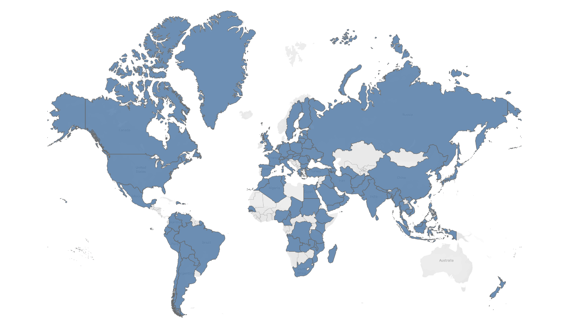
OUR footprint
Rockbuster Stealth LLC is currently in 109 countries and territories

Slide 8
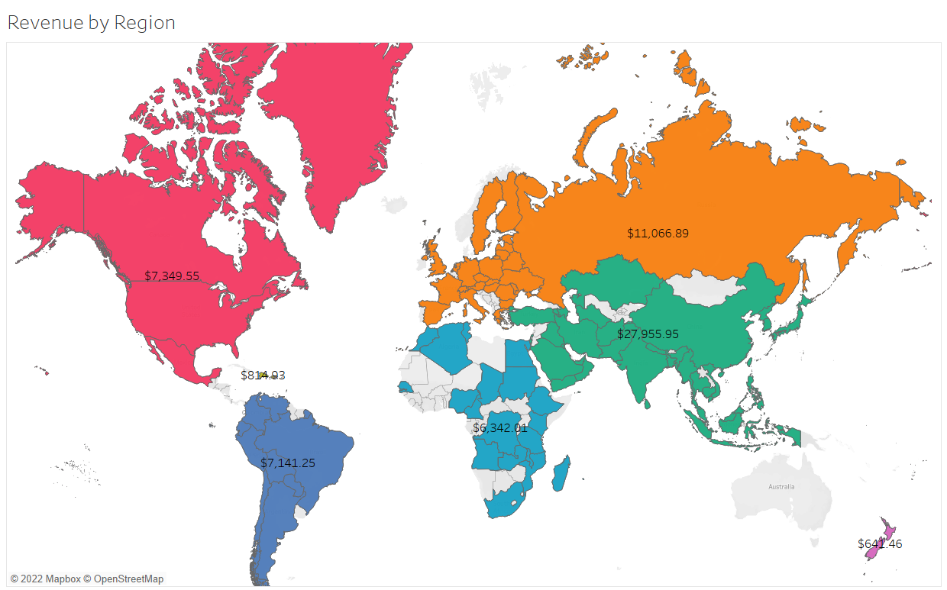
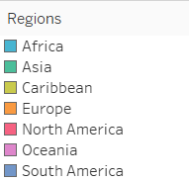
REVENUE BY GEOPRAPHICAL REGION
Geographically, Asia brought in the most revenue with $27,955.95 followed by Europe, then North America for the second and third spot.

Slide 9
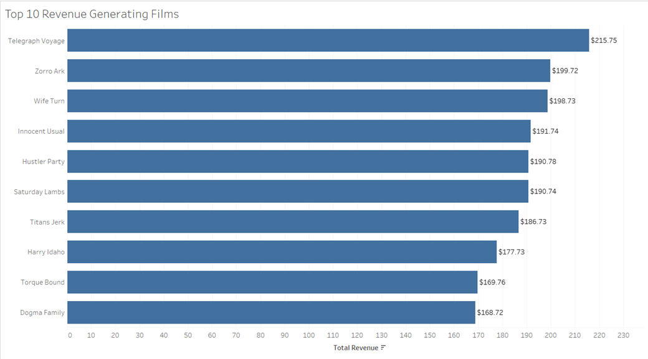
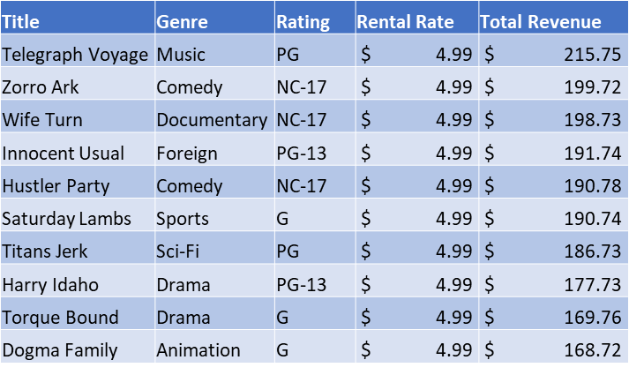
Top 10 Revenue Generating Films
Provided are key statistics about the top 10 revenue generating movies.

Slide 10
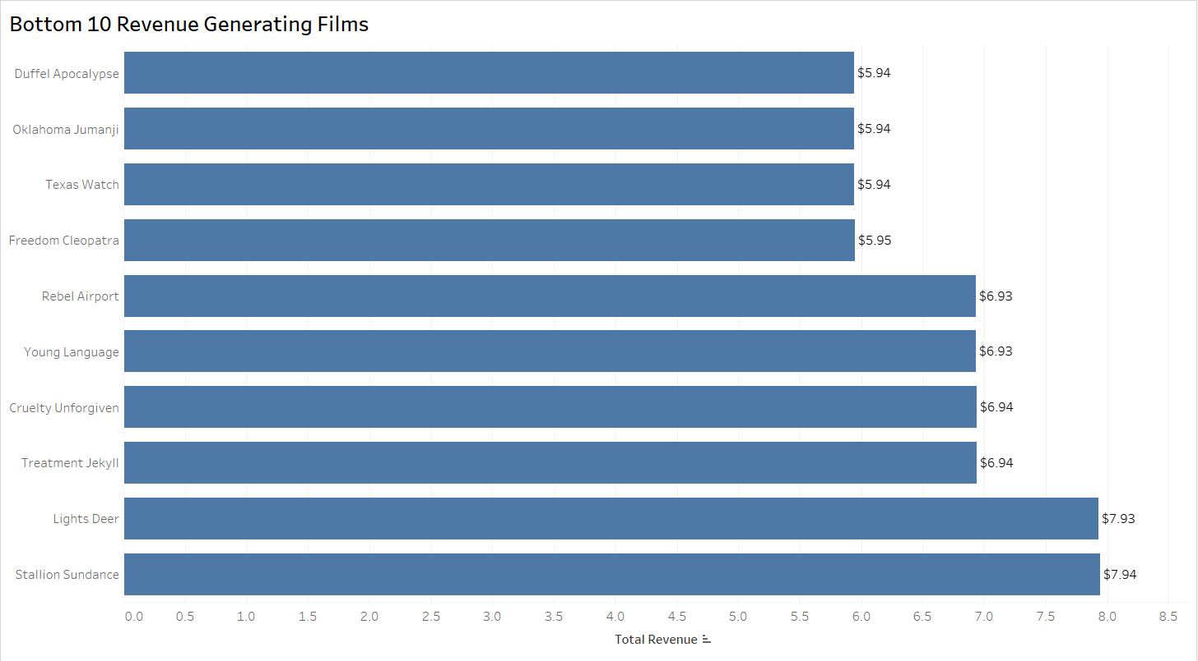
Bottom 10 Revenue Generating Films
Provided are key statistics about the bottom 10 films that generated revenue. Not shown are 42 films that had ‘null’ values and therefore did not generate revenue.
Title | Genre | Rating | Rental Rate | Total Revenue
Oklahoma Jumanji | New | PG | 0.99 | 5.94
Duffel Apocalypse | Documentary | G | 0.99 | 5.94
Texas Watch | Horror | NC-17 | 0.99 | 5.94
Freedom Cleopatra | Comedy | PG-13 | 0.99 | 5.95
Young Language | Documentary | G | 0.99 | 6.93
Rebel Airport | Music | G | 0.99 | 6.93
Treatment Jekyll | Drama | PG | 0.99 | 6.94
Cruelty Unforgiven | Classics | G | 0.99 | 6.94
Lights Deer | Classics | R | 0.99 | 7.93
Stallion Sundance | Sci-Fi | PG-13 | 0.99 | 7.94

Slide 12
Conclusions

Slide 13
Top Performers
Rating
Customers
PG-13 - $13,855.56
Eleanor Hunt of Saint-Denis, Reunion - $211.55
Karl Seal of Cape Coral, United States - $208.58
Marion Snyder of Santa Brbara dOeste, Brazil - $194.61
Rhonda Kennedy of Apeldoorn, Netherlands - $191.62
Clara Shaw of Molodetno, Belarus - $189.60
Genre
Sports - $4,892.19
Country
India- $6,034.78
China - $5,251.03
United States - $3,685.31

Slide 14
GROWTH STRATEGY
How we’ll scale in the future
PHASE 1: Online Video Service launch
Using the current inventory launch online video rental service to India, China, and The United States as these three countries lead in number of customers, transaction count, and revenue generated.
phase 2: Customer appreciation
Implement customer appreciation programs to recognize high lifetime value customers. Ideas include reward system where 10th rental is free or honoring current top 5 high lifetime value customers with next online rental on us to promote the new online service.
PHASE 3: Expanding current inventory
Add more movies to Rockbuster inventory starting with PG-13 and Sports movies as they generate the most revenue.

Slide 15
THANK YOU
Any Questions?
-A more interactive analysis can be found at:
Rockbuster Stealth LLC Tableau Link

